Slide 1
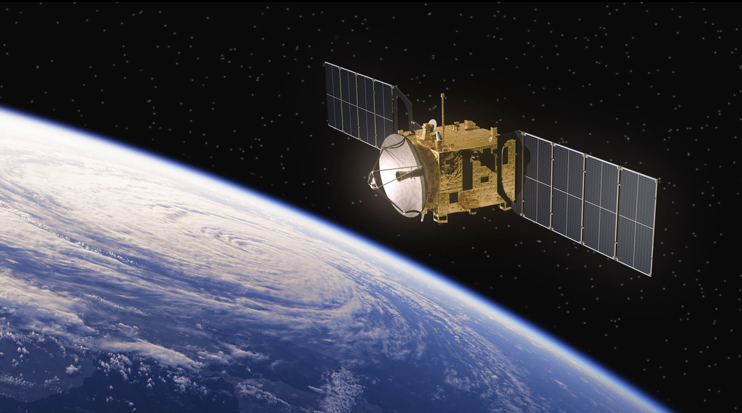
Moons (artificial) around the Head
Santosh Govardhan
Srinija Beesa Gouni
Kunal Malhan

Slide 2
Comparison between Claude AI & Tableau Dashboard

Slide 3
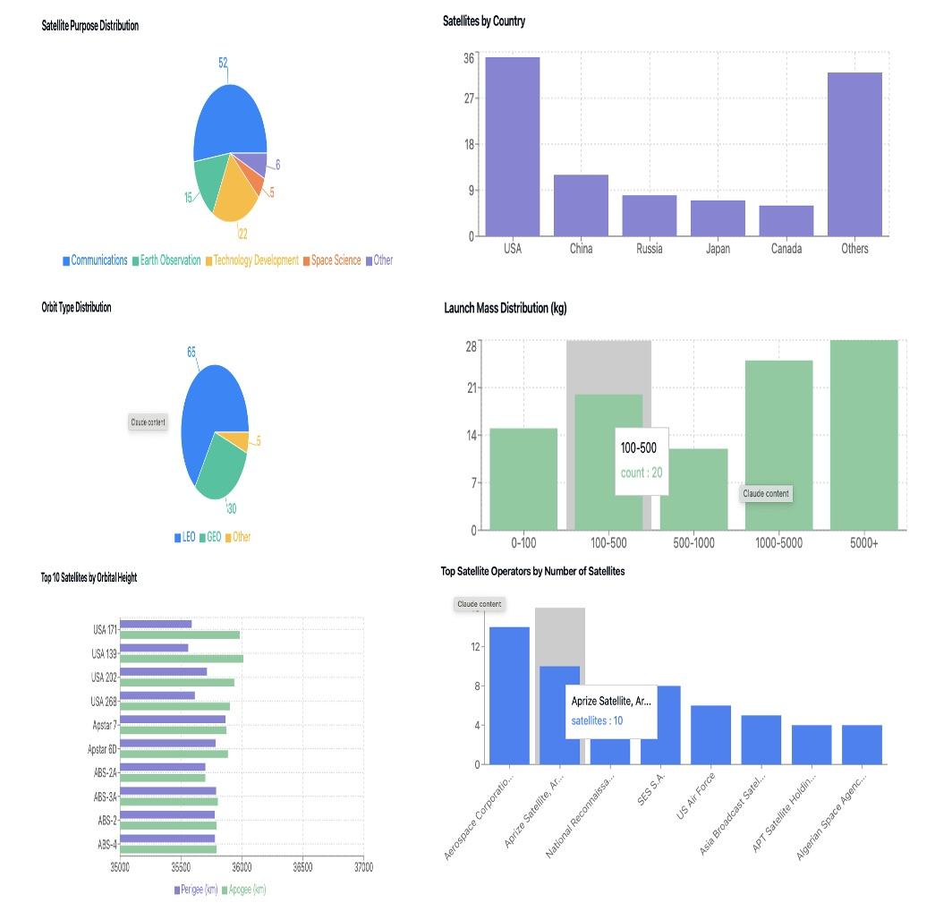
Claude AI Dashboard

Slide 4
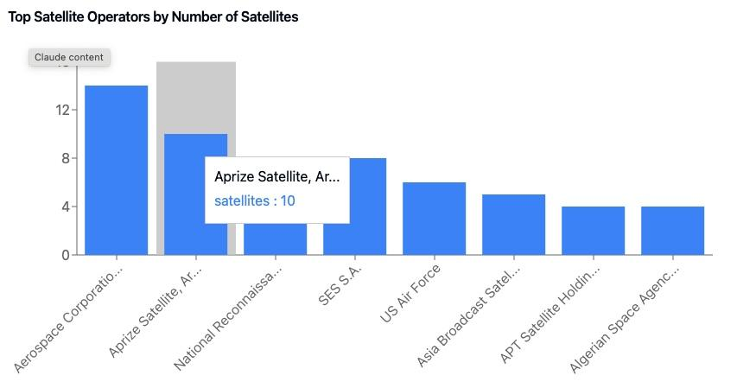
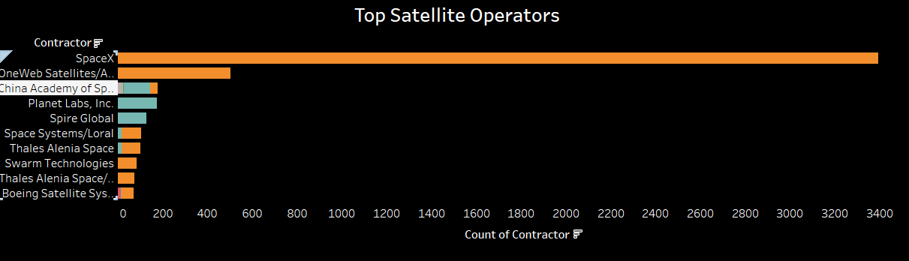
Claude AI vs Tableau – Top satellite operators
AI has given correct visualization of showing bar chart for top satellite operators, but the data is based on only first 100 rows from dataset due to the limitations.
In Tableau it's designed with whole data and additionally satellite purpose distribution(color encoder) is added to the visualization.

Slide 5
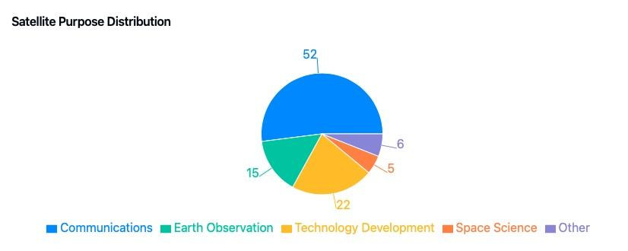
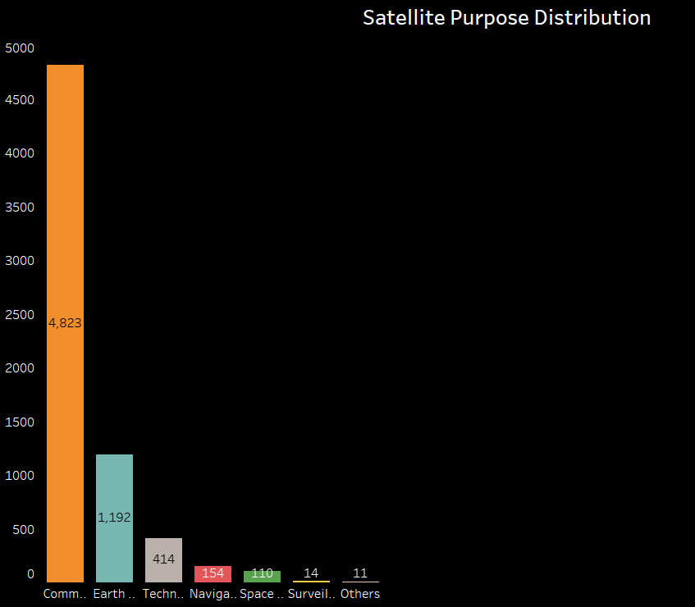
Claude AI vs Tableau – Satellite Research Areas
Here AI has given Pie chart visualization for use of satellites in different research areas, but no proper color encoder or angles chosen.
In tableau it’s bar chart visualization with number of satellites designated to specific research purposes, which shows clear context by looking at the figure.
The thumb rule is that more than 3 categories we should not use pie chart.

Slide 6
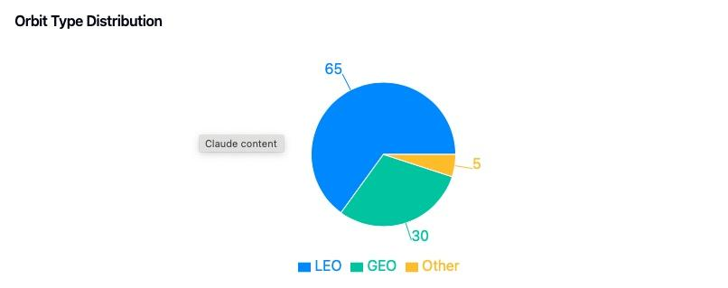
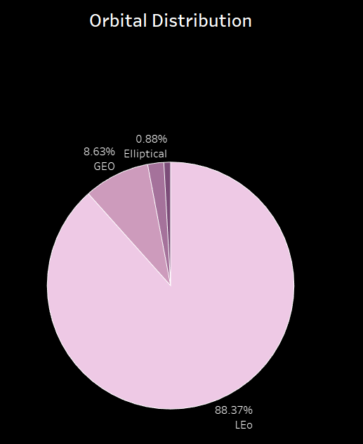
Claude AI vs Tableau – Satellite Orbits
AI has given correct visualization Pie chart to show the number of satellites in Earth centered orbits. Color encoding, distribution is clearly stated.
In tableau pie chart is designed to show number of satellites in % for each orbits (LEO, GEO, MEO, Elliptical) and by looking at proportion and color it can be said more number of LEO orbit satellites around earth.

Slide 7
Reflection of AI Assistance
Use of AI helped us to explore data, to come up with better questions
The visualization and insights was not on point, but gave us a starting point to think and make it better using principles of data viz
We understood that asking specific questions led to to ai bettering its response
“Afterall everything starts with a question and power of curiosity is still very human”

Slide 8
Earth and its Satellites
Situation

Slide 9
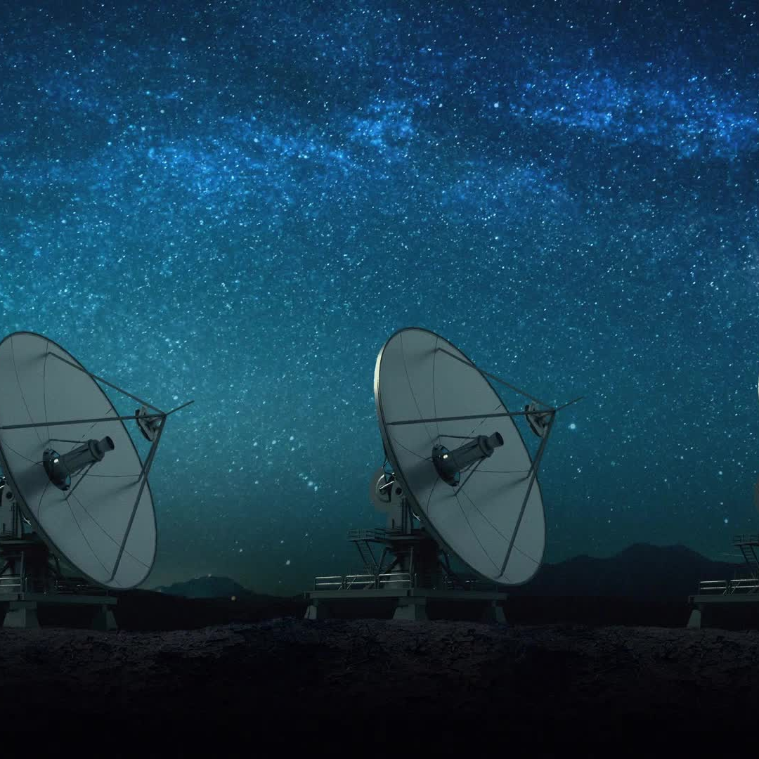
Context
The need for space exploration, global connection and developing countries expanding their Space research has led to an explosion in space industry. Creating a void of needing more space players.
The dataset represents the operational and non-operational satellites in orbit, showcasing their research areas, ownership, orbits, launch site & time and technical specifications of the satellite.
We explored From the dataset it is noticed that increasing demand of satellites from 2016 till 2023 for communication, Earth observation, and technology development drives the growth of satellite launches around Earth. There are more number of satellites in space including inactive satellites and other space junk which are raising concerns of space sustainability.

Slide 10
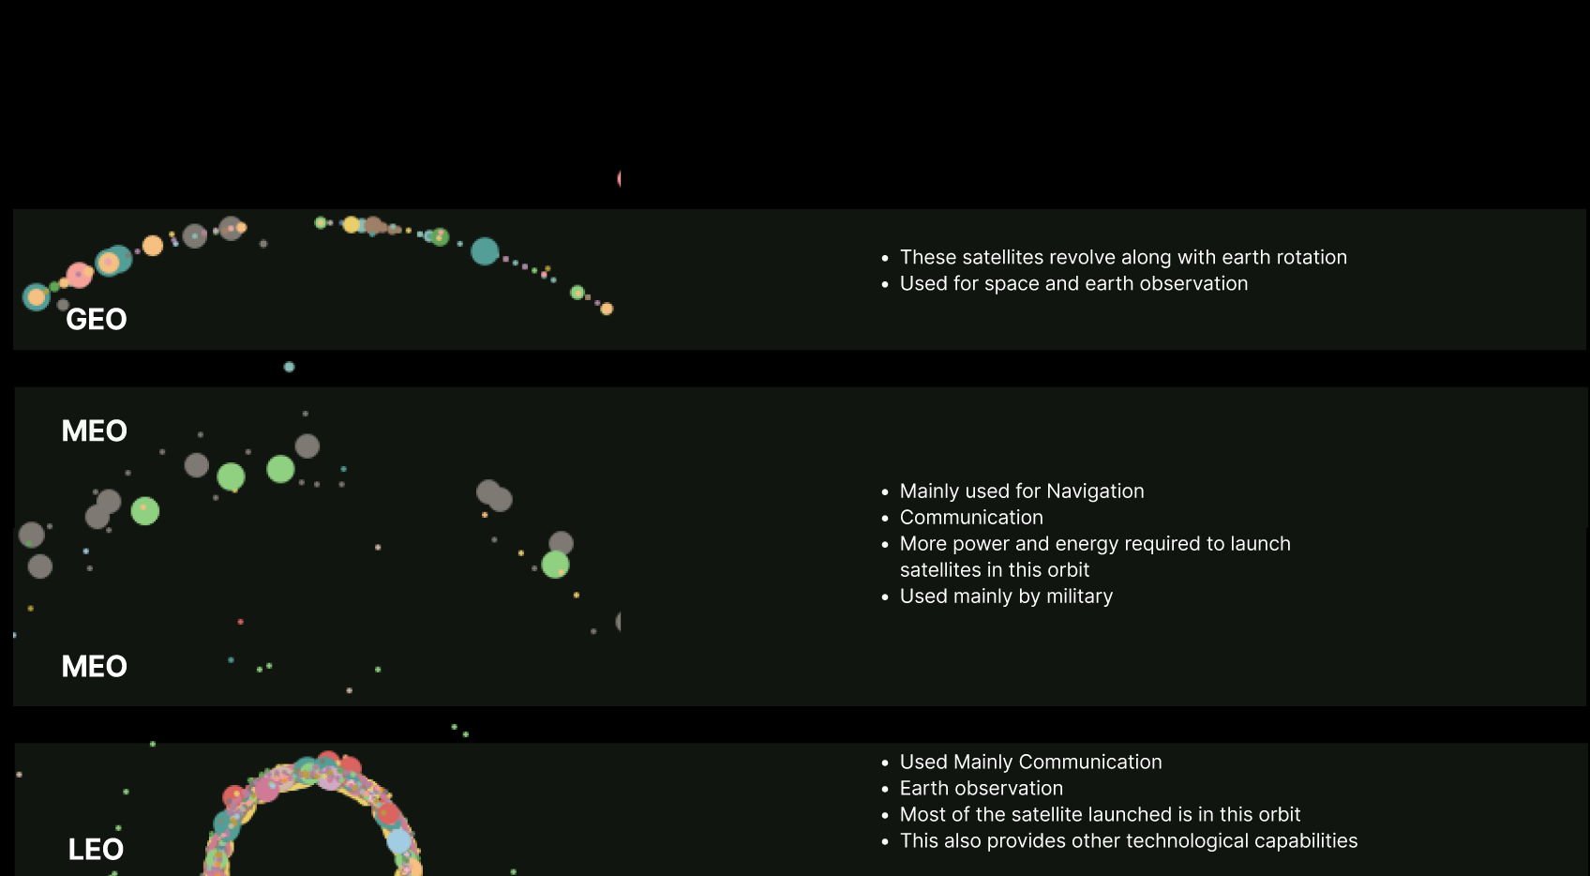

Satellites and Its Orbits

Slide 11
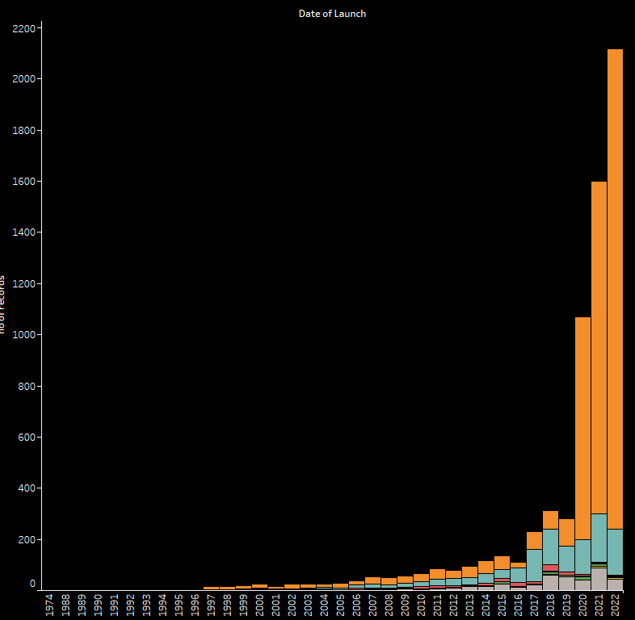
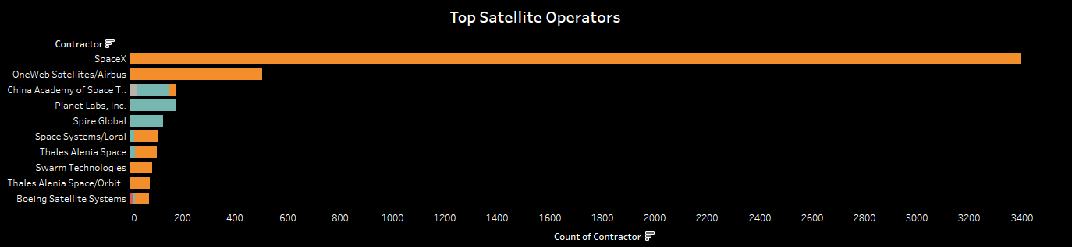
Satellites launch trends
Satellite Launched year wise
Top Satellite Operators
Post 2016 saw x10 times increase in the number of satellites launched.
80% of satellites launched were for communication activities
This boom is because of private players entering the space market eg:SpaceX
SpaceX is also one the largest service provider.

Slide 12
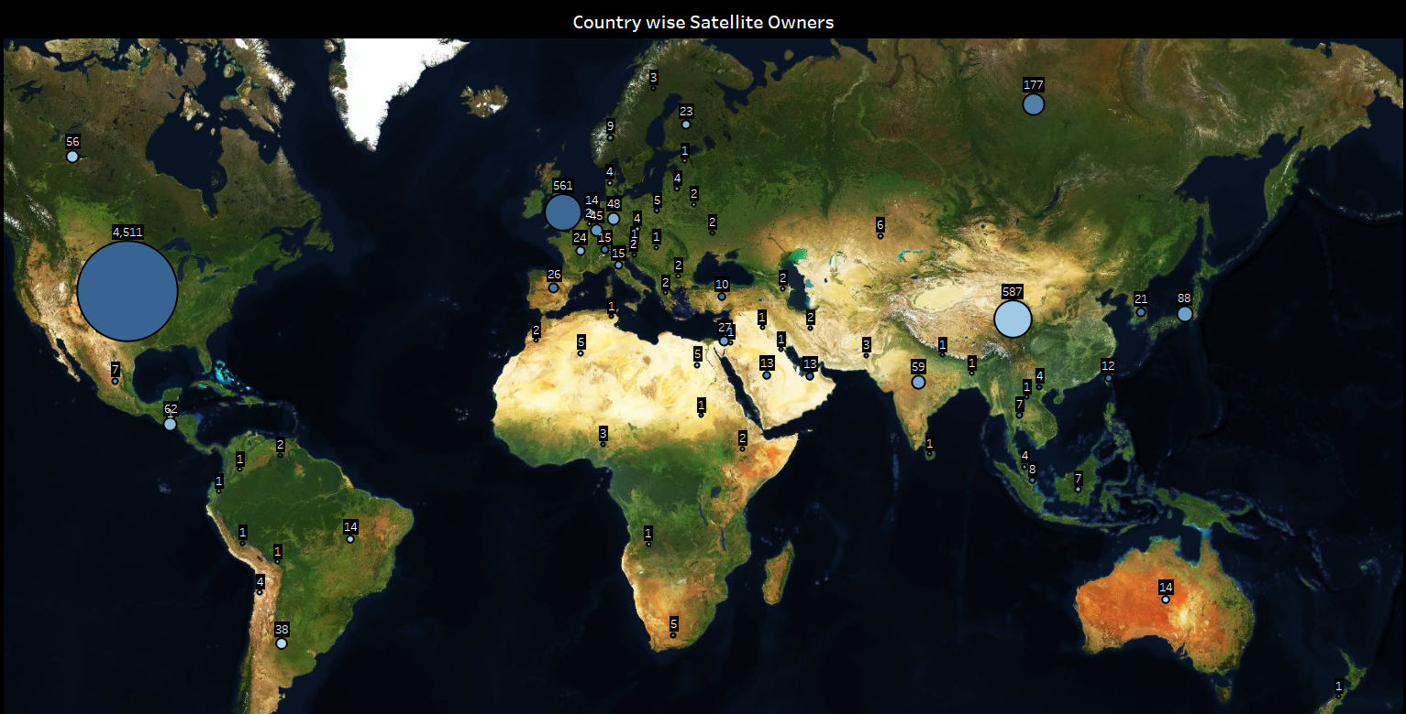
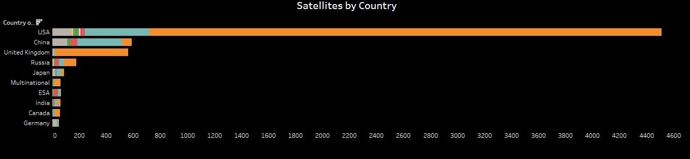
Which countries are launching satellites?
USA has launched the most number of satellites
Most of private space companies are in USA
China, United Kingdom and Russia also play significant role in launching satellites.

Slide 13
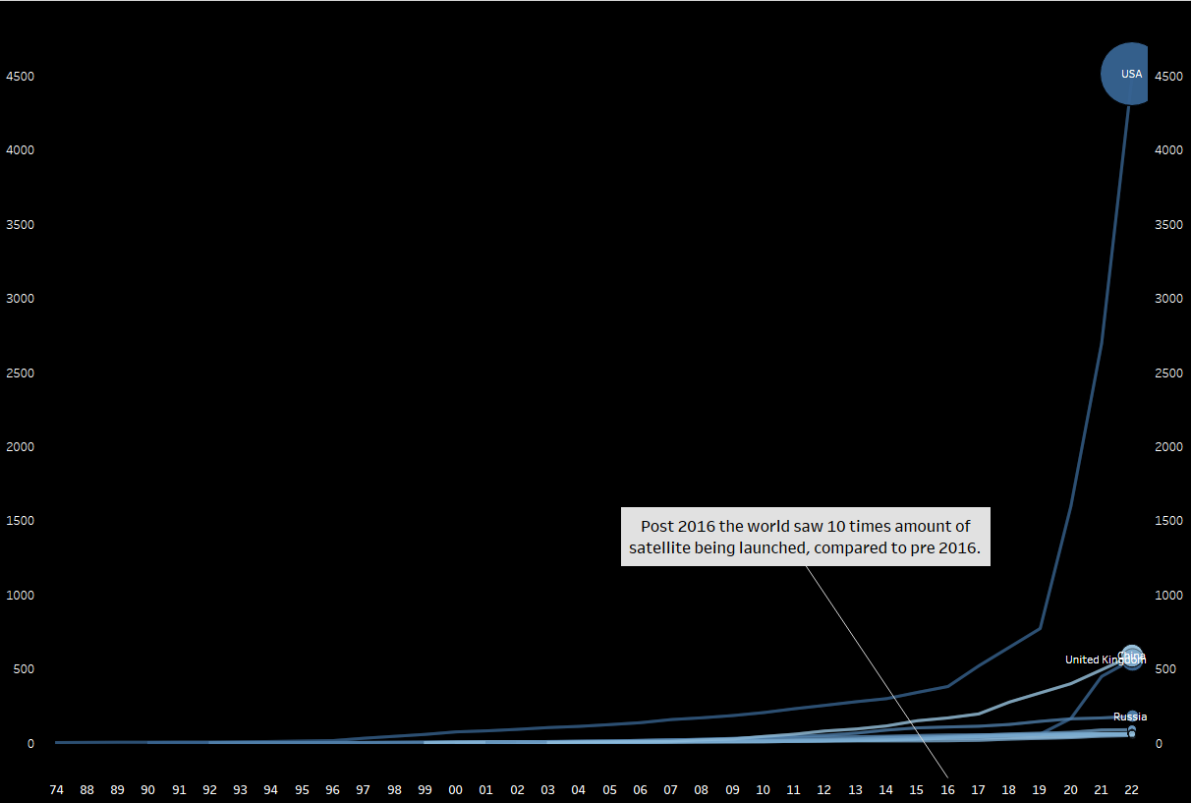
Satellites launched each year countries

Slide 14
The dark side of the Moon The Space Junk
Complication

Slide 15
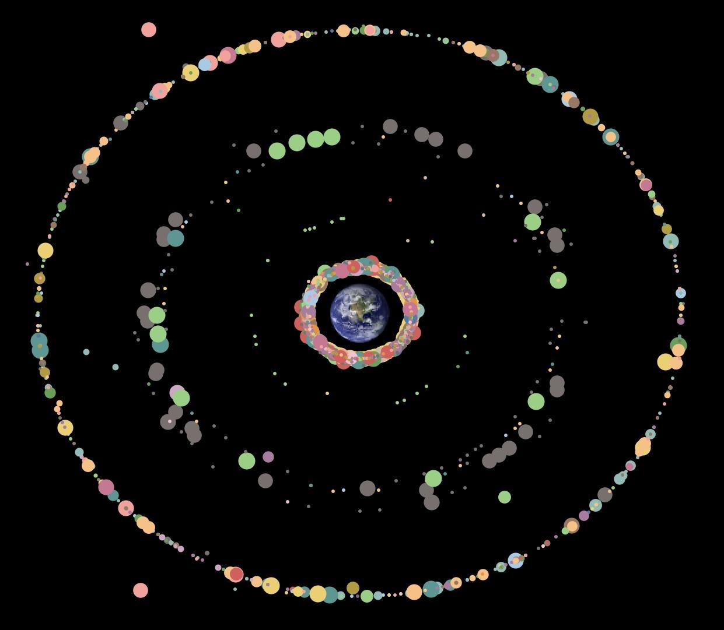
Earth Orbit and Satellites - Now

Slide 16
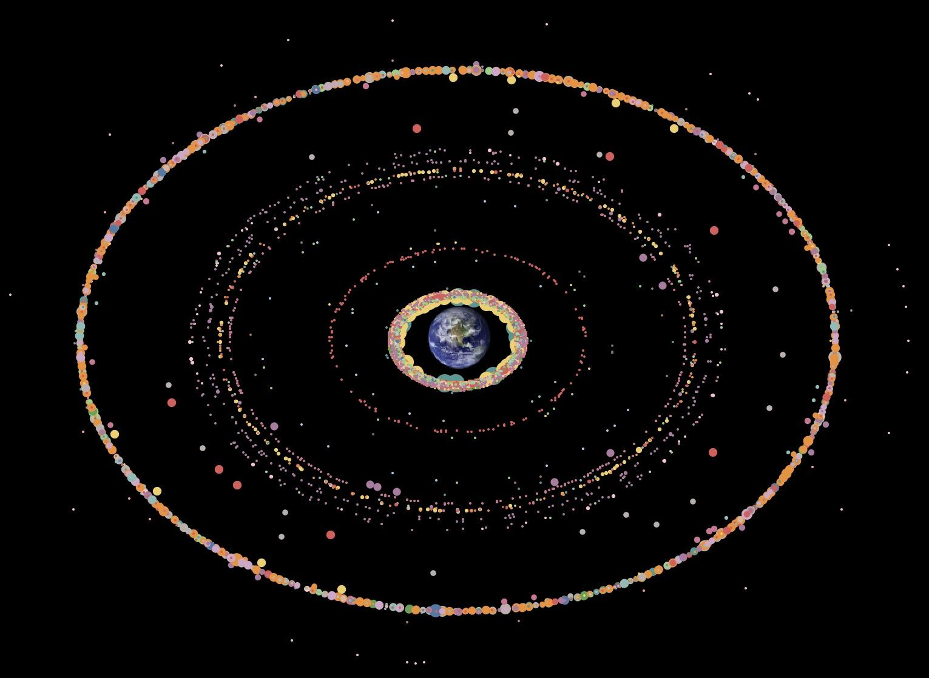
Earth Orbit and Satellites – 2050 (Expected)

Slide 17
Is this a problem?
Question

Slide 18
Growing inactive satellites – A problem?
When a satellite is no longer working, it continues to orbit the Earth until gravity pulls it down.
The United States Space Surveillance Network (SSN) detects, tracks, catalogs and identifies artificial objects orbiting Earth, e.g. active/inactive satellites, spent rocket bodies, or fragmentation debris.
But…
Kessler Syndrome
If the amount of satellites and space debris becomes too high, collisions can occur, creating more debris and leading to more collisions.
No one has been confirmed to have died from falling space debris, but the risk is growing as the number of satellites in orbit increases. The Federal Aviation Administration (FAA) estimates that by 2035, one person could be killed by falling satellites every two years.

Slide 19
Recommendations
Answer

Slide 20
Solution lies arounds (not single solution fits all)
Self-destructive satellite
Mimic a typical reentry into Earth's atmosphere, but with the help of the rocket it was launched with to steer it into a swift reentry.
European Space Agency's (ESA) Draco mission.
Pushing inactive satellites in space
This option can require a lot of fuel, can be used for GEO satellites only.
Laser broom.

Slide 21
A few more solution (not single solution fits all)
Laser Broom
Involves using a high-powered laser to ablate, or remove material from, the debris. This process imparts a small thrust that lowers the debris's orbit, increasing drag and shortening its orbital life. The debris can then be nudged into a lower orbit or re-entered into the Earth's atmosphere.
Multipurpose Satellite
A satellite that can carry various payloads and perform a variety of tasks.

Slide 22

Thank you
THE Earth and the moon

